Slide 1





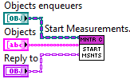









1
call parent’s method
method name
method’s object class
method’s block diagram snippet
message transport
message recipient method
expand method’s block diagram

Slide 2


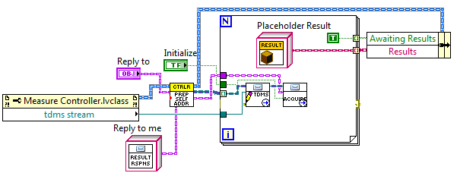





2

Slide 3


3
Actor class tree
Instrument driver class tree

